Slide 1
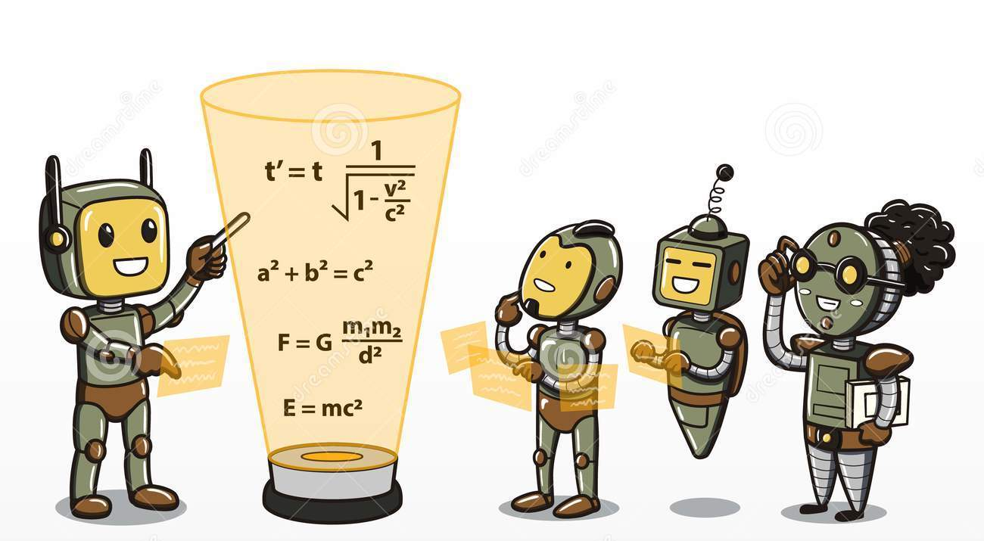
CSE 445: Machine Learning
Introduction
Instructor: Syed Athar Bin Amir, North South University

Slide 2
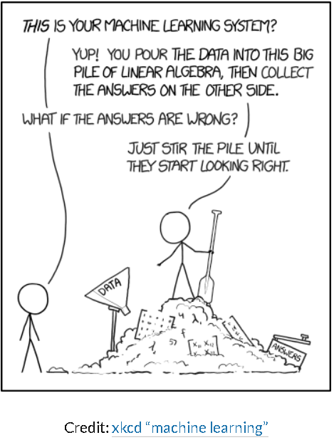

Slide 3
Resources
Slides provided in course should be enough – but there is a plethora of fantastic resources available, so use them!
Recommended Books:
Hands-On Machine Learning with Scikit-Learn, Keras, and Tensorflow by Aurelien Geron (will be followed extensively in the course with code examples from https://github.com/ageron/handson-ml )
Pattern Recognition and Machine Learning by Christopher Bishop (excellent resource for mathematical foundations)
Elements of Statistical Learning by Jerome Friedman et al (good reference)
Additional Material:
Andrew Ng’s course on Machine Learning available on Coursera
CS 189, Berkeley
CS 229, Stanford

Slide 4
Helpful Prerequisites
MAT361- Probability & Statistics
Probability distribution, Random Variable, Conditional Probability, Variance (some of the important concepts to recall to name a few)
MAT125 – Linear Algebra
Matrix Multiplication, Eigenvalues, Eigenvectors
Basic programming background in Python (an OK understanding of python syntax is all that’s necessary – Geron’s textbook has excellent code examples)
None of them are compulsory – easier to grasp the material if completed

Slide 5
Assessment (tentative)
In-class pop quizzes on Socrative (15%)
Midterm (20%)
Final (30%)
Project (30%)
Class Participation (5%)

Slide 6
Course Project
Groups of up to 4 members (4 is a hard maximum)
Video Demo submission at the end of the semester, and in-person/online presentation at the end of the semester
4-6 page Report due at semester end, IEEE format – must include link to Github repo
Potential Topics (few examples):
Covid-19
Computer Vision
Natural Language Processing
Reinforcement Learning
Speech & Music Recognition
Biomedical Imaging and Biosignals

Slide 7
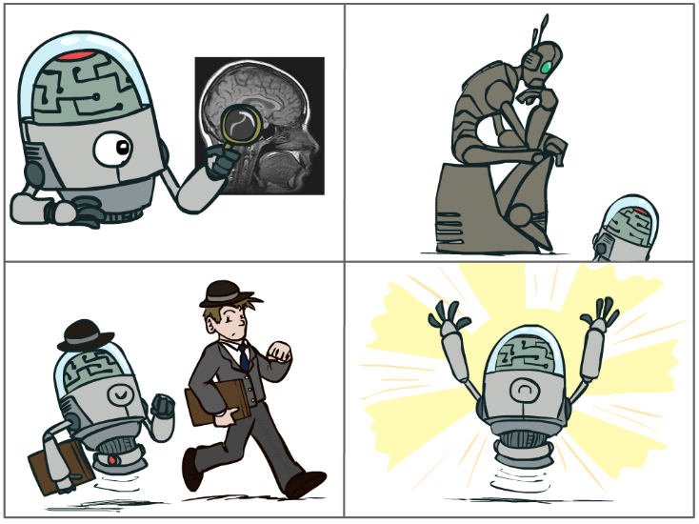
What is Artificial Intelligence?
The science of making machines that:
Think like people
Think rationally
Act like people
Act rationally
“Machines that act rationally” – a fairly broad definition!
Notes:
Top left: Think like people --- cognitive science, neuroscience
Bottom left: act like people --- actually very early definition, dating back to Alan Turing --- Turing test; problem to do really well you start focusing on things like don’t answer too quickly what the square root of 1412 is, don’t spell too well, and make sure you have a favorite movie etc. So it wasn’t really leading us to build intelligence
Think rationally – long tradition dating back to Aristotle --- but not a winner, because difficult to encode how to think, and in the end it’s not about how you think, it’s about how you end up acting

Slide 8
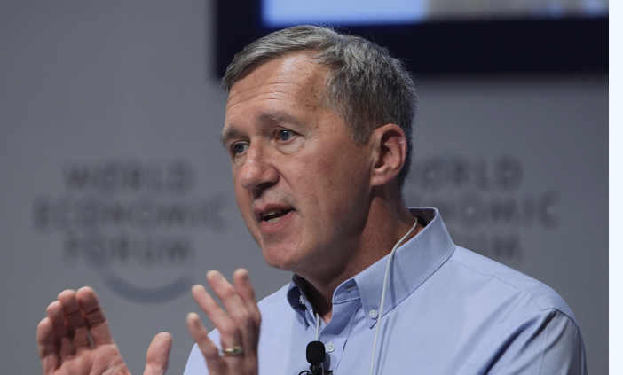
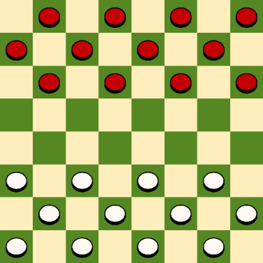
What is Machine Learning?
Tom Mitchell (1998): a computer program is said to learn from experience E with respect to some class of tasks T and performance measure P, if its performance at tasks in T, as measured by P, improves with experience E.
Example:
Task: Playing Checkers
Experience (data): games played by the program (with itself)
Performance measure: winning rate
Image from Tom Mitchell’s homepage

Slide 9
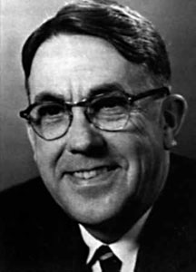
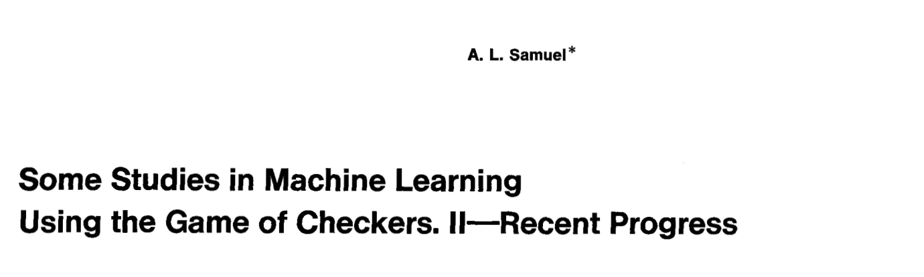
Definition of Machine Learning
Arthur Samuel (1959): Machine Learning is the field of study that gives the computer the ability to learn without being explicitly programmed.
Photos from Wikipedia

Slide 10
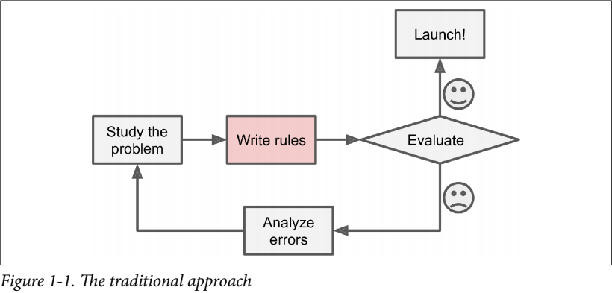
Traditional Programming
Traditional Programming: writing a set of RULES to find ANSWERS from DATA

Slide 11
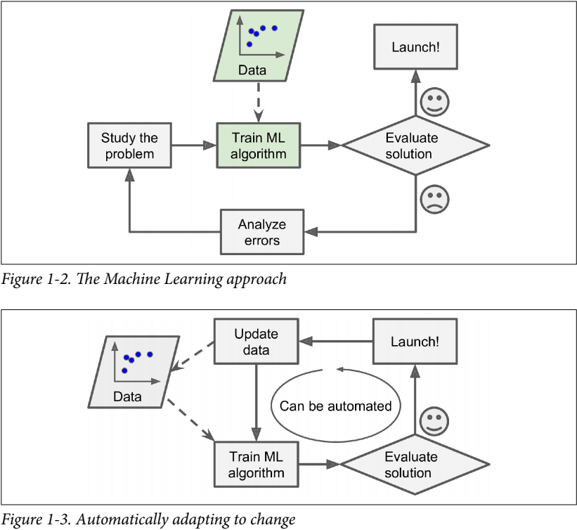
The ML Approach
Machine Learning: Use DATA and ANSWERS to learn the underlying set of RULES
Great for:
Problems that require a lot of fine-tuning or long list of rules
Changing environments – ML systems can ADAPT
Getting insights from large amounts of data
Complex problems that yields no good solution with traditional approach

Slide 12
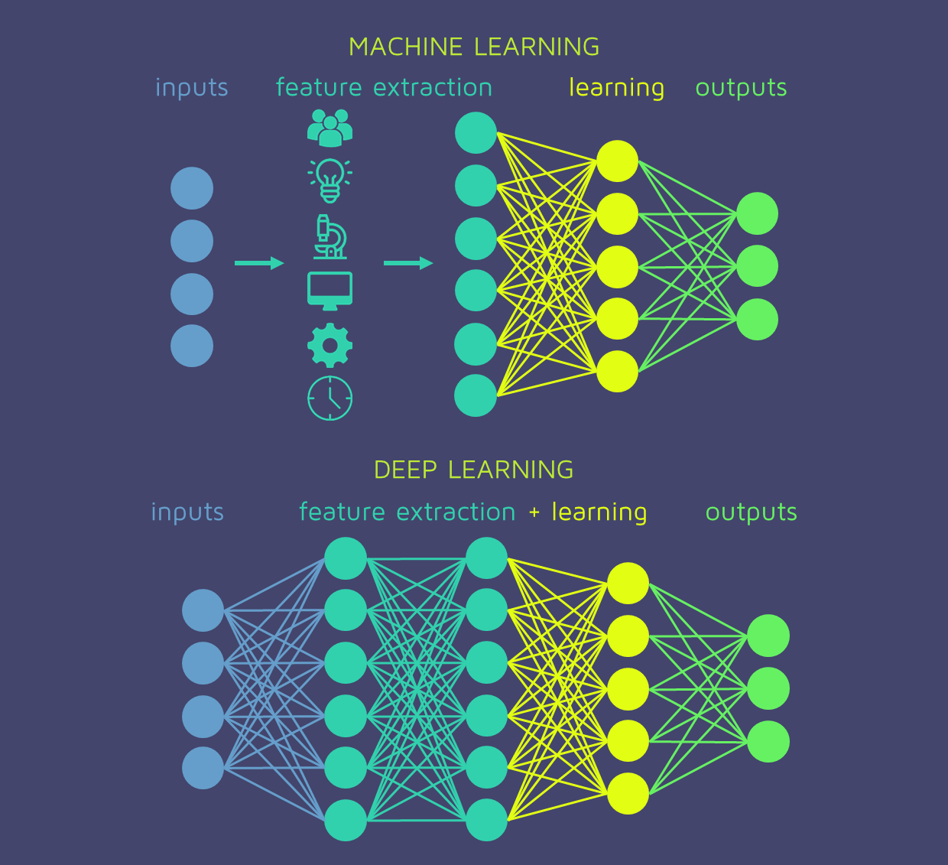
Deep Learning
Subset of ML - loosely mimics structure/function of human brain
Unlike traditional ML, does not require manual feature extraction
Keeps getting better with more data (typically)
Computer Vision (CNN, GAN)
Natural Language Processing (RNN, LSTM)
Automatic Speech Recognition (RNN)

Slide 13
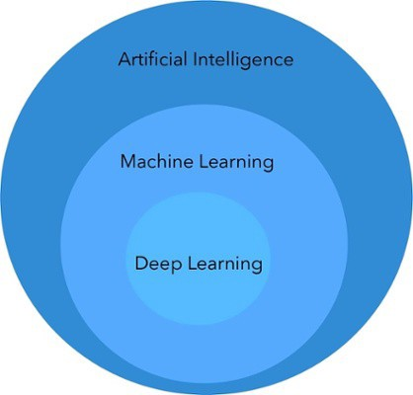
Summary – AI vs ML vs DL
Subsets of each other
1950 – 1990: AI in the form of Expert systems (airplane autopilot) and Games (checkers, chess)
1990- : Statistical Approaches with ML, busts AI winter
2010 - : Deep Learning revolutionizes CV, NLP among other applications
Narrow AI
Systems can do a few defined things (such as playing chess, or driving a car) as well, or better than humans
Can’t do EVERYTHING a human being can do – yet
AI is not “taking over the world” anytime soon
Tell your uncles to relax and stop using Whatsapp

Slide 14
What kind of ML system is it?
Useful to classify ML systems based on the following criteria:
1. Does it require human supervision?
Supervised Learning
Semisupervised Learning
Unsupervised Learning
Reinforcement Learning
3. Does the system build a predictive model?
Model-based Learning
Instance-based Learning
These are not exclusive – can be combined
e.g. Spam filter may learn on the fly with a deep neural network – online, model-based, supervised learning system
2. Can it learn incrementally on the fly?
Online Learning
Batch Learning

Slide 15
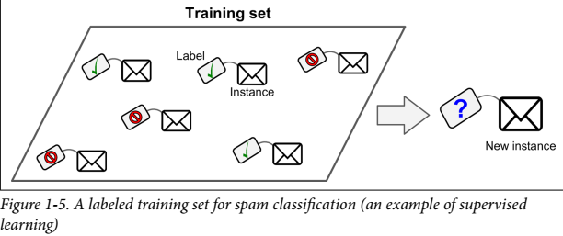
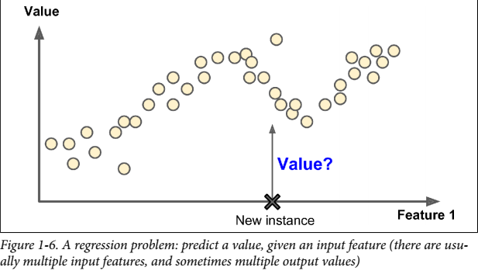
Supervised Learning
Training data fed to algorithm includes the desired answers/solutions (labels)
Example algorithms:
Linear Regression
Logistic Regression
SVM
Decision Tree
Neural Network

Slide 16
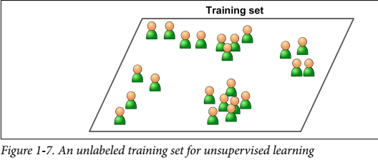
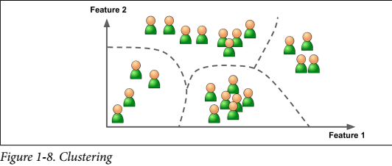
Unsupervised Learning
Training data is unlabeled
System learns without direct human supervision
Widely used in:
Clustering
Anomaly detection
Association mining
Data preprocessing
Example algorithms:
K-means
PCA
SVD
ICA

Slide 17
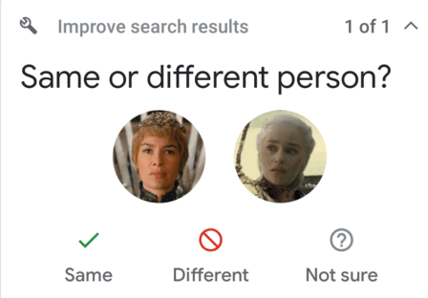
Semisupervised Learning
Partially labeled data
Unsupervised learning used to cluster similar data together
Human input taken to label the clusters
e.g. Google Photos will cluster similar faces, and ask the user if they are the same person

Slide 18
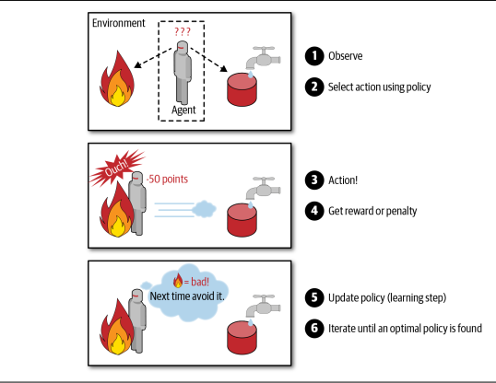
Reinforcement Learning
The learning system (agent) can:
Observe the environment
Select and perform an action
Get rewards/penalties as a result
Learns what the best policy should be
Policy defines what actions should be chosen in a certain situation
Very effective in controlled environments (such as a game of chess)
With the progress in deep learning, increasingly used in more complex tasks (such as driving the mars rover)

Slide 19
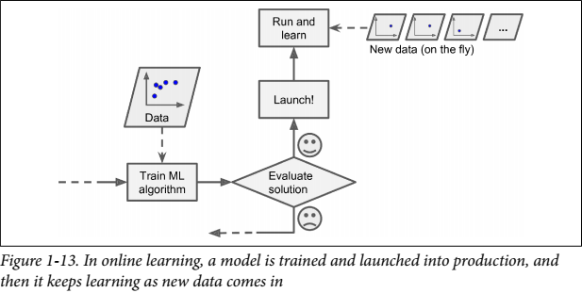
Batch Learning vs Online Learning
Batch Learning
Not capable of learning after deployment
Must be retrained from scratch – computationally expensive!
Online Learning
Can continue to learn after deployment
Can take advantage of parallel computing – no down time
Preferred choice in production

Slide 20
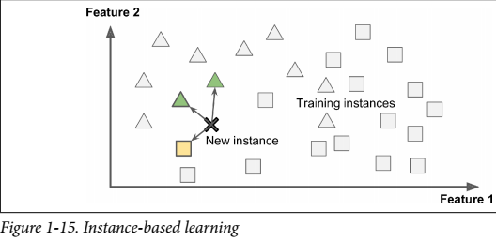
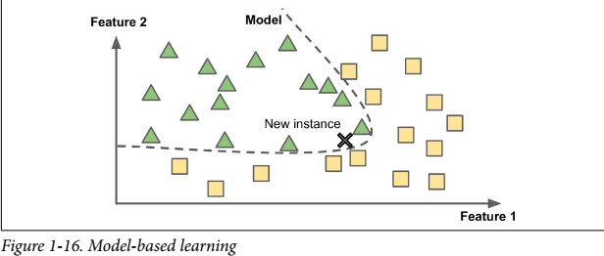
Instance-Based vs Model-Based Learning
Two approaches to generalization
Instance-based Learning
Memorize known data
Use similarity measure to generalize new instances
e.g. new instance is a triangle because it’s similar to the other triangles
Model-based Learning
Build model from training data
Predict based on model output

Slide 21
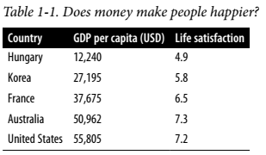
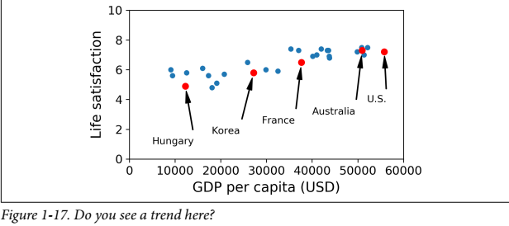
Example ML Task: Does money make people happy?
Life Satisfaction data from OECD
GDP per capita data from IMF
What relationship can we infer between life satisfaction and GDP per capita from the graph?

Slide 22
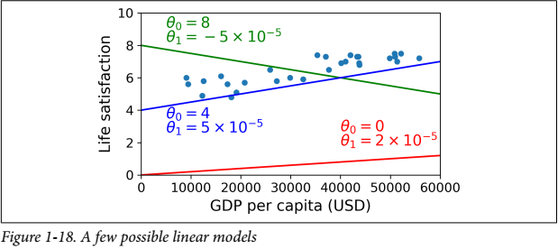
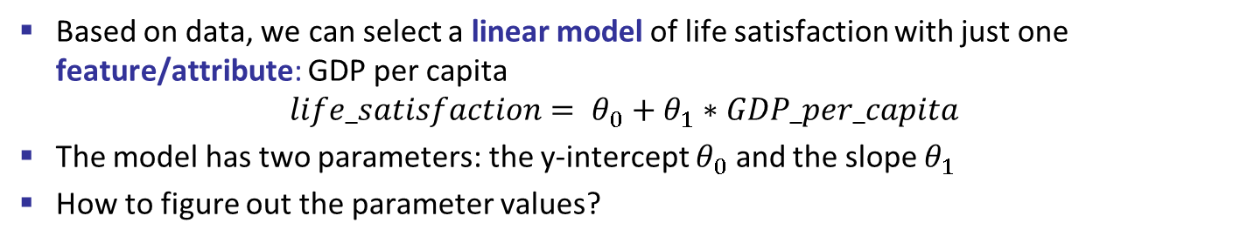
Model Selection
Based on data, we can select a linear model of life satisfaction with just one feature/attribute: GDP per capita
$$life_satisfaction= θ_{0}+θ_{1}∗GDP_per_capita$$
The model has two parameters: the y-intercept $θ_{0}$ and the slope $θ_{1}$
How to figure out the parameter values?

Slide 23
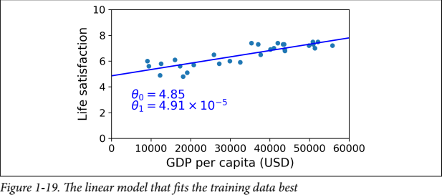
Performance Measure
Define a utility function (how good is the fitted line?), or a cost function (how bad is the fitted line?)
Linear Regression
Training: try to minimize distance between linear model’s prediction on the line, vs the actual training examples, until the estimated parameter values converge
In this example, Linear Regression gives $θ_{0}=4.85$ and $θ_{1}=4.91∗{10}^{−5}$

Slide 24
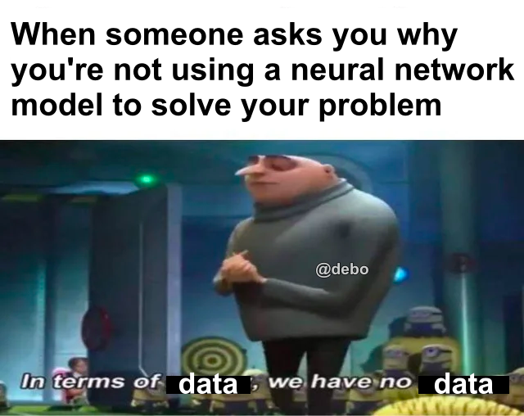
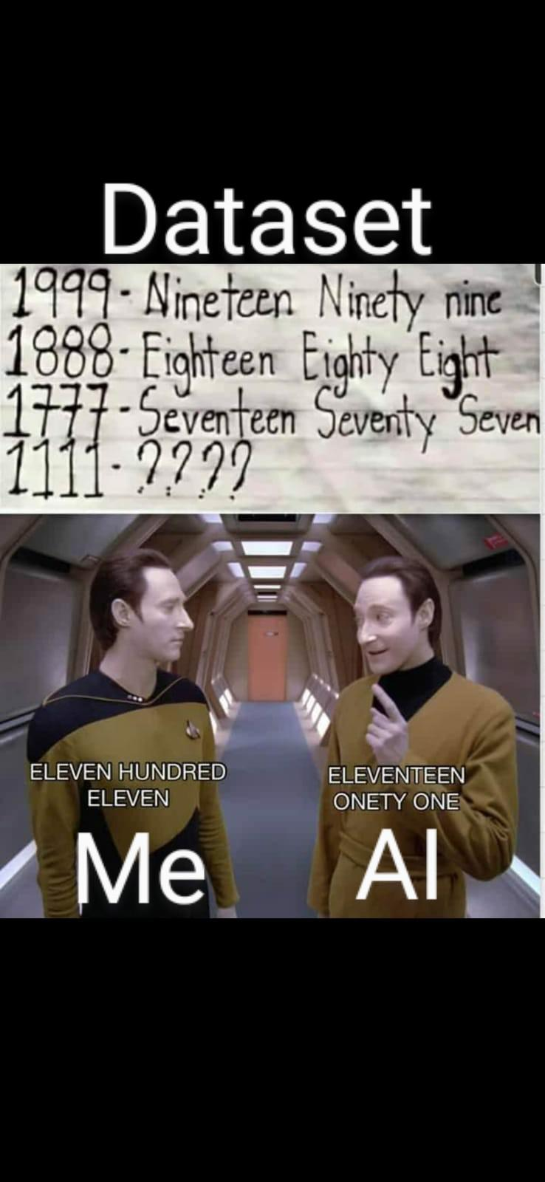
Problems with Machine Learning
3 V’s of Big Data
Volume, Variety, Velocity
Problem #1: Training data!
Insufficient quantity
Nonrepresentative data
Poor-quality data
Problem #2: How “fit” is it?
Overfitting data
Underfitting data
Problem #3: Which features should be used?
Deep Learning automates feature selection

Slide 25
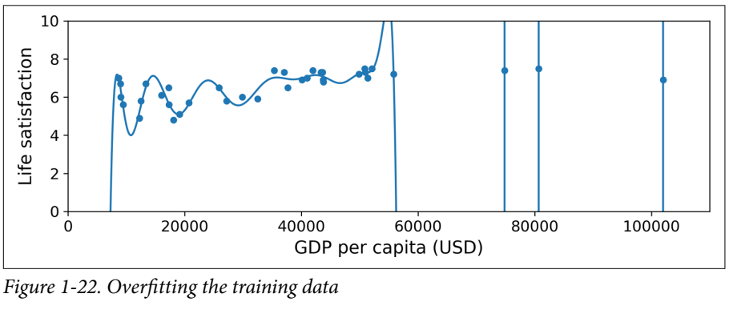
Overfitting
Most common problem in ML – do not overgeneralize!
The polynomial model is better than the linear model on training
How about testing?

Slide 26
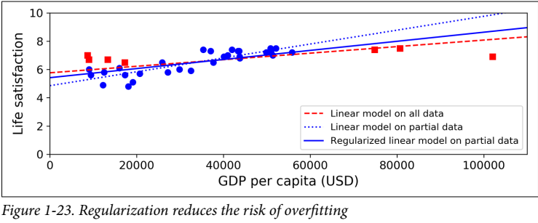
How to avoid overfitting
Tip #1: REGULARIZATION – USE IT
Constrain model to keep it simple – reduce risk of overfitting
If you can stand on one leg, you’ll be able to stay balanced with two legs
Hyperparameters – control level of regularization
Tip #2: Get more training data, and reduce noise in it

Slide 27
Model Evaluation
How good is your model?
Test it on new data – data not seen by the model ever before!
Keep 80% for training, set 20% for testing
NEVER go below 10% test data – better model is better than better “accuracy”
How to regularize?
Keep a portion of training data held out for validation
Alternatively, use cross-validation (many validation sets instead of one)
Pick the hyperparameters that work best on validation for your model on the test dataset

Slide 28
Ratios
A great model
trained with 60% training data, 20% validation data, and 20% testing data
An okay model
trained with 70% training data, 15% validation data, and 15% testing data
A barely-acceptable model
trained with 80% training data, 10% validation data, and 10% testing data
Models with worse ratios – hacks
Unless there’s millions of instances in the dataset
“No Free Lunch” theorem
Only way to know for sure which model works best is to evaluate them
Make reasonable assumptions about your data to select model

